Slide 1
Introduction to DBMS
(Database Management Systems)
Application
program
DBMS
End-user
1-<number>

Slide 2
Database Management System (DBMS) provides….
  … efficient, reliable, convenient, and safe
  multi-user storage of and access to massive
  amounts of persistent data.

Slide 3
Massive
Persistent
Safe
Multi-user
Convenient
Efficient
Reliable

Slide 4
What is DBMS
Database Management System (DBMS) is a system software that provides …
  Massive – terabytes of data
  Persistent – Data outlives the program, multiple programs may operate on the same data
  Safe Guarantees that the data managed by the system will stay in a consistent state, it won't be lost or overwritten when there are hardware or software failures
1-<number>
Notes:
What a database management system provides for applications
Massive: database systems are handling terabytes of data, sometimes even terabytes of data every day.
And one of the critical aspects is that the data that's handled by database management systems
systems is much larger than can fit in the memory of a typical computing system.
So memories are indeed growing very, very fast, but the amount of data in the world and data to be handled by
database systems is growing much faster. Database systems are designed to handle data that to residing outside of memory.
Secondly, the data that's handled by database management systems is typically persistent.
It means data in the database outlives the programs that execute on that data.
If you run a typical computer program the program will start the variables we created.
There will be data that's operated on the program, the program will finish and the data will go away.
It's sort of the other way with databases.The data is what sits there and then program will start up, it will operate on the
data, the program will stop and the data will still be there. Very often actually multiple programs
will be operating on the same data.
Safety, since they run critical applications such as
telecommunications and banking systems,
have to have guarantees that
the data managed by the system
will stay in a consistent
state, it won't be lost or
overwritten when there are
failures, and there can be hardware failures.

Slide 5
What is DBMS
Multi-user - users and programs, concurrency control
Convenient - Physical data independence; Logical data independence
  High level query languages (declarative – what you want, not how )
Efficient - Performance, performance, performance – thousands of queries (updates) per second
Reliable - Banking, Telecommunication (99.99999%)
1-<number>

Slide 6
Database applications may be programmed via “frameworks”
  Ruby on Rails, Django
DBMS may run in conjunction with “middleware”
  Application server, web server etc.
Data-intensive applications may not use DBMS at all
  Data sits on file
  Hadoop is operational framework for running operations on data in files

Slide 7

Component of Database Application
Interact
End users
…
Software
Application
Program
Develop
Application
developer
What to get
DBMS
Maintain
DB
Administrator
How to get date
Database
Design
DB Designer
Data
Users

Slide 8
Key concepts
Database
  Shared collection of logically related data build upon data model
Data model: how data is structured
  Relational, XML (tree structured), Object, object relational, hierarchical, Network (graph),
  NOSQL, key-value, document data model (JSON)
Architecture of a DBMS
  Three levels: external, conceptual and internal schema
Schema versus data
  Data types vs variable in programming language
Data definition language (DDL)
  Set up the schema
Data manipulation or query language (DML)
  Querying and modifying
1-<number>

Slide 9
Assignment: Review Key Concepts
Text Book: Database Systems (6th edition) by Elmasri and Navathe
1.1 -1.9
1-<number>

Slide 10
Advantages of a DBMS
Program-Data Independence
  Insulation between programs and data: Allows changing data storage structures and operations without having to change the DBMS access programs.
Efficient Data Access
  DBMS uses a variety of techniques to store & retrieve data efficiently
Data Integrity & Security
  Before inserting salary of an employee, the DBMS can check that the dept. budget is not exceeded
  Enforces access controls that govern what data is visible to different classes of users

Slide 11
Advantages of a DBMS
Data Administration
  When several users share data , centralizing the administration offers significant improvement
Concurrent Access & Crash Recovery
  DBMS schedules concurrent access to the data in such a manner that users think of the data as being accessed by only one user at a time
  DBMS protects users from the ill-effects of system failures
Reduced Application Development Time
  Many important tasks are handled by the DBMS

Slide 12
REVIEW CONCEPTS
Text Book: Database Systems (6th edition) by Elmasri and Navathe
Chapter 2: Database System Concepts and Architecture
1-<number>

Slide 13
Data Model Overview
What is data model ?
Why data models are important ?
How the major data models evolved ?
Basic data-modeling building blocks.

Slide 14
What is Data Model
Data Model: A set of concepts to describe the structure of a database, and certain constraints that the database should obey.
  Representations, usually graphical, of complex real-world data structures
  Facilitate interaction among the designer, the applications programmer and the end user
    End-users have different views and needs for data
    Data model organizes data for various users
Data Model Operations: Operations for specifying database retrievals and updates by referring to the concepts of the data model. Operations on the data model may include basic operations and user-defined operations.

Slide 15
Type of Data Models
Entity-Relation Diagram (RDBMS)
Hierarchical
UML modeling (Object Oriented Programming)
Semi-Structured (XML, JSON)
1-<number>

Slide 16
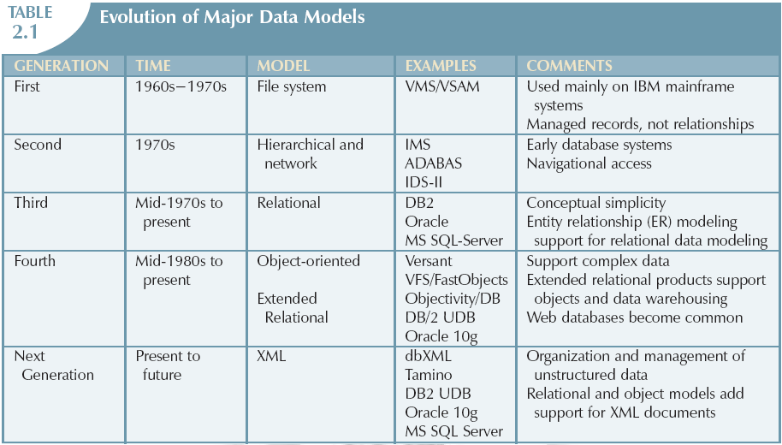
The Evolution of Data Models

Slide 17
ER Model :Basic Building Blocks
Entity
  Anything about which data will be collected/stored
Attribute
  Characteristic of an entity
Relationship
  Describes an association among entities
    One-to-one (1:1) relationship
    One-to-many (1:M) relationship
    Many-to-many (M:N or M:M) relationship
Constraint
  A restriction placed on the data

Slide 18
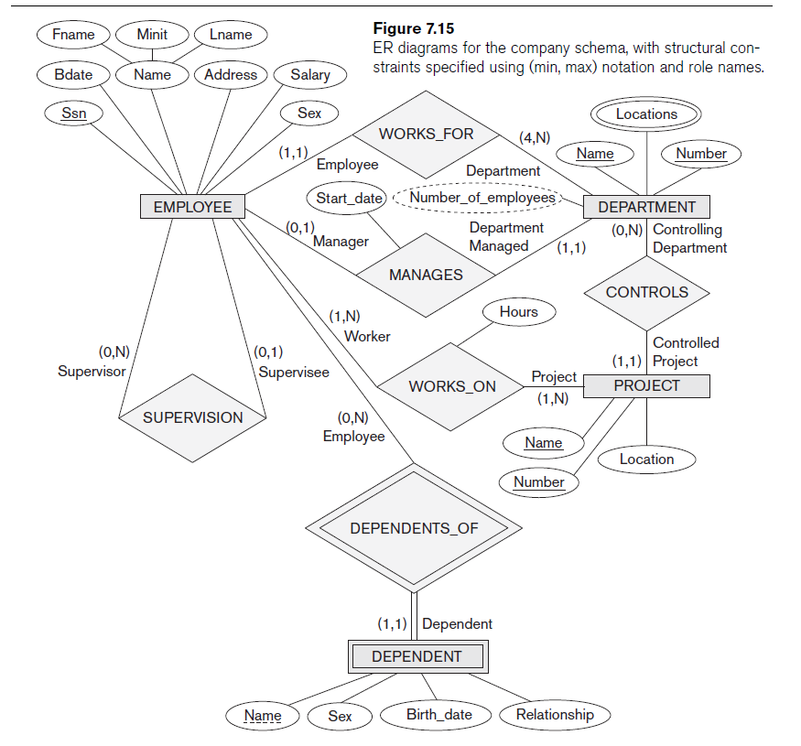

Slide 19
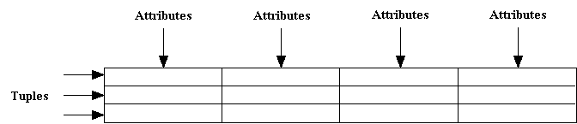
Relational DB model

Slide 20
RDM- Language Support
Data Manipulation Language or DML, sql statements that insert, update or delete database in a database.
Data Definition Language or DDL, sql used to create and modify database objects used in an application schema.
Declarative Languages:
Declares what to do; doesn’t have to write the detail algorithms (how to do it) = convenience

Slide 21
Hierarchical DB model (TREE)
SALIENT FEATURES
Logically represented by an upside down TREE
Each parent can have many children
Each child has only one parent
The top layer is perceived as the parent of the segment directly beneath it.
The segments below other segments are the children of the segment above them.

Slide 22
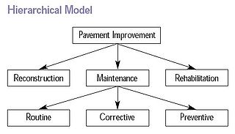
Hierarchical DB model

Slide 23
Example
PARENT
Emp No. | First Name | Last Name | Dept Num
100 | John | Dougals | 2A
101 | Antony | Wanton | 2B
102 | Mary | Queen | 2C
103 | David | Moorey | 2D
CHILD
Serial No. | Type | User Emp No.
3009734-4 | Computer | 100
3-23-283742 | Monitor | 100
2-22-723423 | Monitor | 100
232342 | Printer | 100

Slide 24
Disadvantages
Complex implementation
Difficult to manage and lack of standards
Lacks structural independence
Applications programming and use complexity
Implementation limitations (no M:N relationship)

Slide 25
Object Based Data Models
Use Objects Structure to describe data at logical and view level also called
  Logical level is used by DBA, who decide what information is to be kept in database
  View level describe only part of entire database to be viewed by the user of the database hiding the detail of information stored
Examples:
  Object oriented model
  Semantic data model
  Functional data model

Slide 26
Object Data Model
Basic constructs
Object
Class
Attribute
Operation
Relationships
Association
Aggregation
Composition
Generalization
Students
StudentID
Name
Birthday
Address
computeGPA()
computeAge()
Courses
CourseID
CourseName
Unit
register()
1
1
Grades
StudentID
CourseID
Grade
getStatus()
M
M

Slide 27
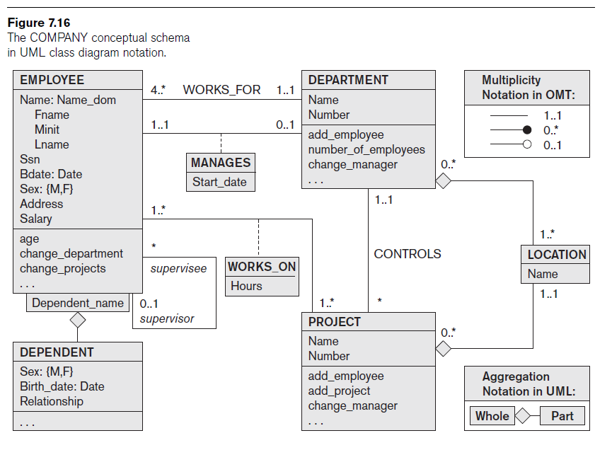

Slide 28
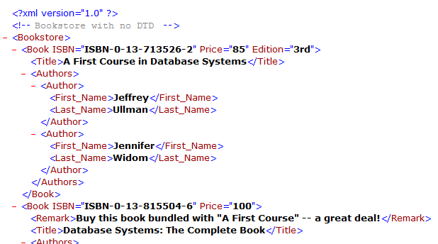
Extensible Markup Language (XML)
Standard for data representation and exchange
  Document format similar to HTML
    Tags describe content instead of formatting
  Also streaming format
Basic constructs
Tagged elements
(nested)
Attributes
Text

Slide 29
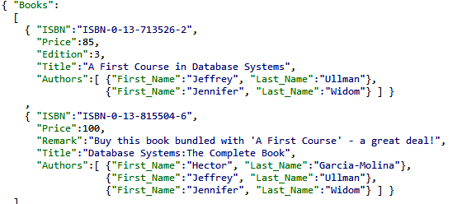
JavaScript Object Notation (JSON)
Standard for “serializing” data objects, usually in files
  Human-readable, useful for data interchange
  Also useful for representing & storing
  semistructured data
Basic constructs
(recursive)
Base values
number, string, boolean, …
Objects { }
sets of label-value pairs
Arrays [ ]
lists of values

Slide 30
Conclusions
Relational Database is not everything.
There are more about databases
Modeling is crucial
DBMS built over sophisticated mathematical or theoretical models can take advantage of the underlying models.
XML database; Object-Oriented (OO) database; Parallel and Distributed databases and many more advanced database technologies

